Slide 1
Capstone Project - Sports Analysis
By Abhishek Attri

Slide 2
Participant Analysis
Valuable Insights: The Power BI dashboard using the Sports Database provides valuable insights into the games performance.. It presents data-driven analytics on Medals, Gender, age of Participant etc.
Improvement Focus: The dashboard helps the Sports focus on areas that require improvement. By analyzing Games,Age, Countries, the dashboard identifies opportunities to optimize age and most valuable game.
Trend Identification: Using historical Sports data, the dashboard identifies trending game over time. It helps identify seasonal patterns and the success of certain games and Players. This trend identification empowers the games to plan for future Sports in Olampic more effectively.
Comprehensive Understanding: The Power BI dashboard offers a comprehensive understanding of Sports Played in Olamic. By presenting data on Games, best Player, and season in centralized platform. This comprehensive understanding enables better decision-making and a more cohesive strategy across all aspects of the Olamic Sports.
Medals Analysis
Season & Players Analysis
Sports Analysis
Age Analysis

Slide 3
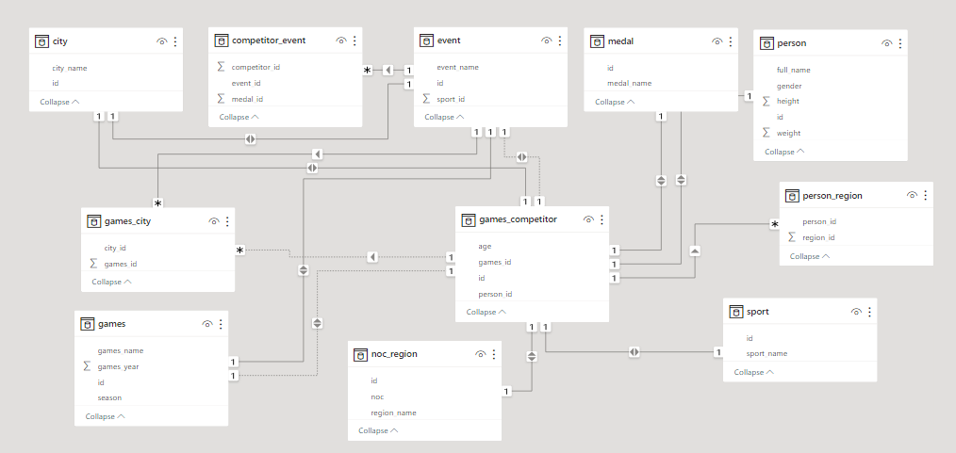
ER Diagram

Slide 4


Slide 5
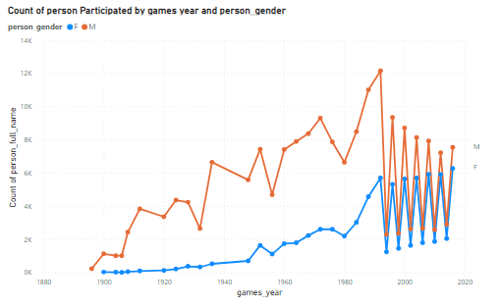
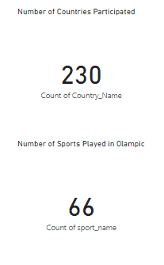
Participant Analysis

Slide 6
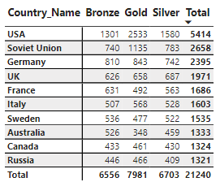
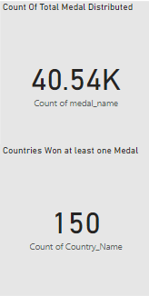
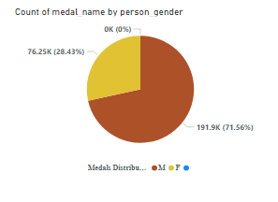
Medals Analysis

Slide 7
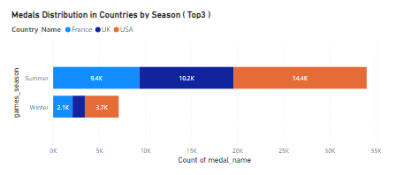
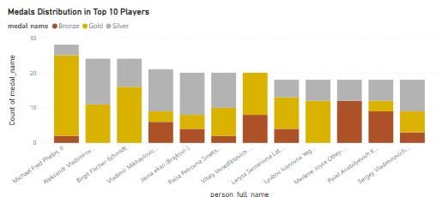
Medals distribution by Season & Players

Slide 8
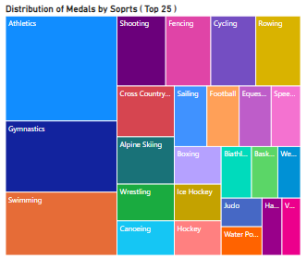
Sports Analysis

Slide 9
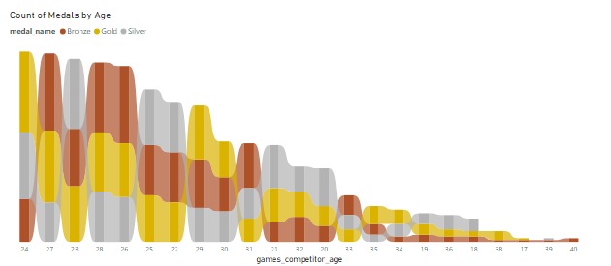
Age Analysis

